Slide 1
Lecture 7 Robot Software (PEPPER)
Samuele Vinanzi
Department of Computer Science, Kilburn Building,
The University of Manchester

Slide 2

CODING FOR humanoid robots

Slide 3
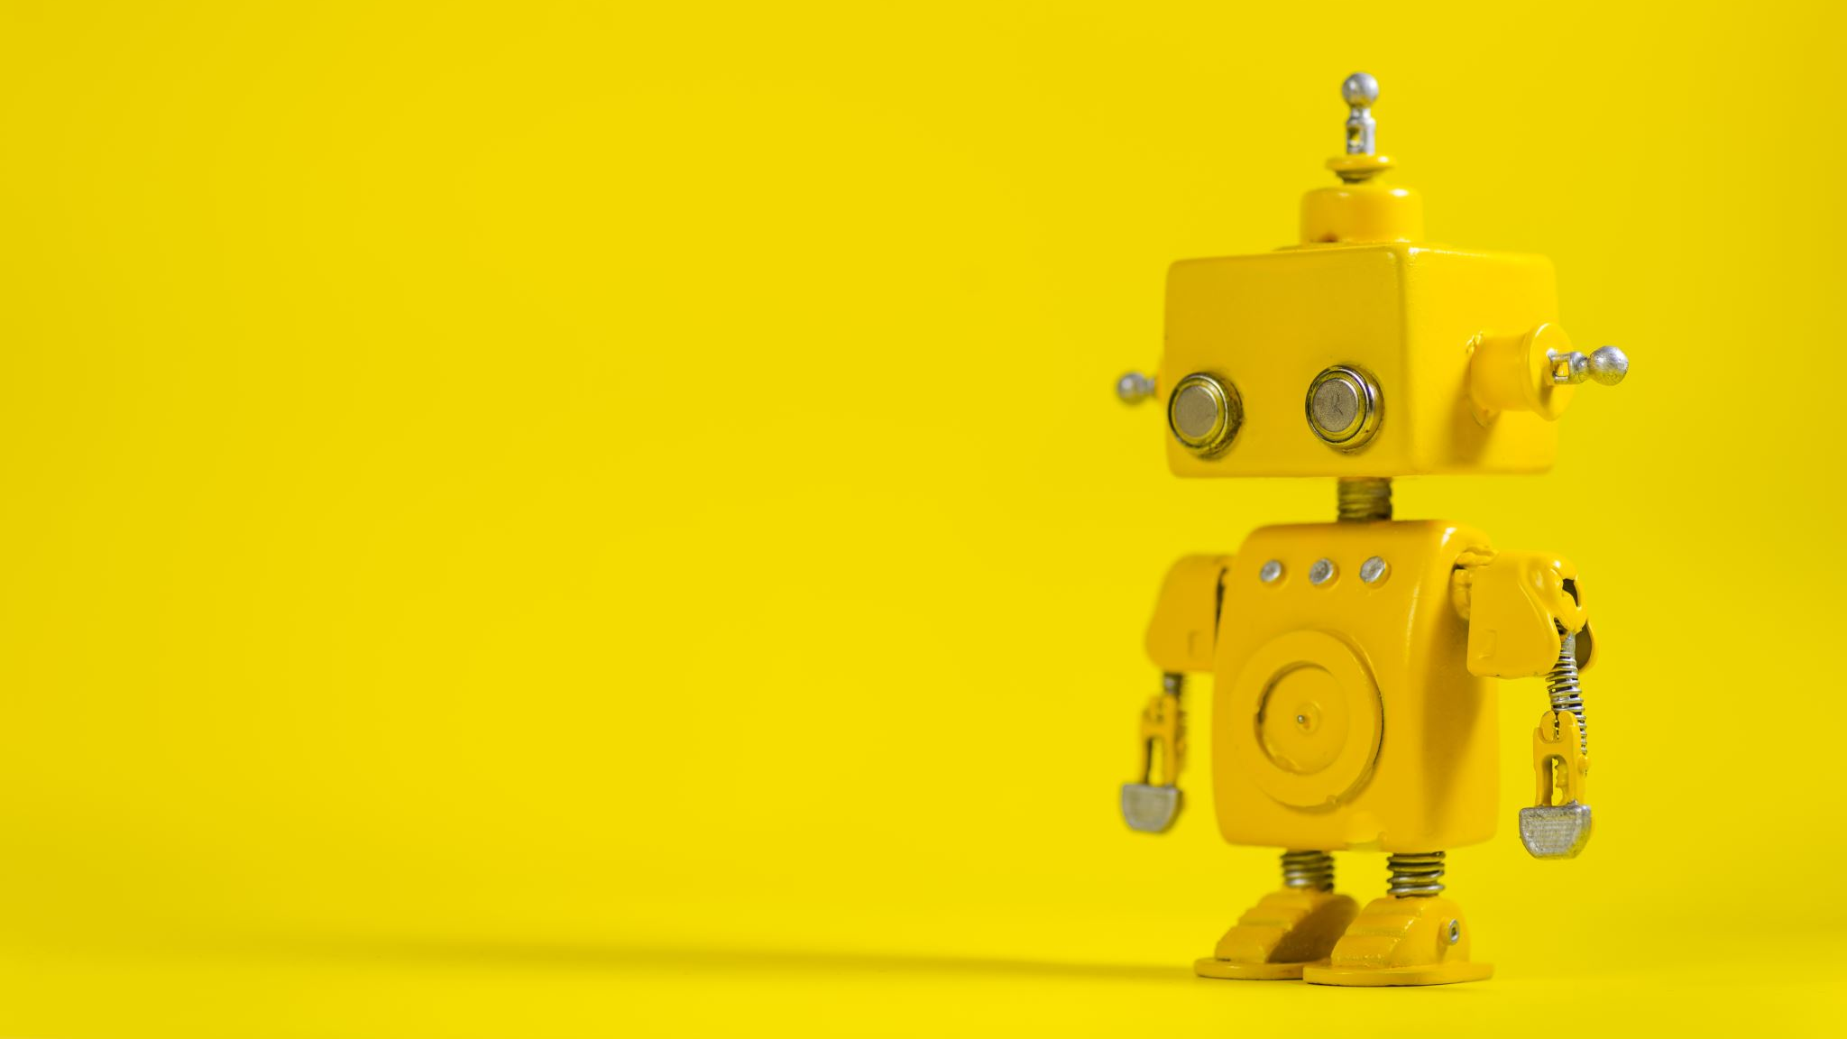
Expected learning outcomes
One 1-hour technical lecture followed by two 2-hours practical labs.
What are you going to learn from them?
Anatomy of a common humanoid robot
What is a middleware and which libraries are currently available for robotics
How to use Choregraphe to graphically program a Pepper robot
How to code for Pepper using Python and NAOqi
You are expected to develop hands-on skills in robotics.

Slide 4
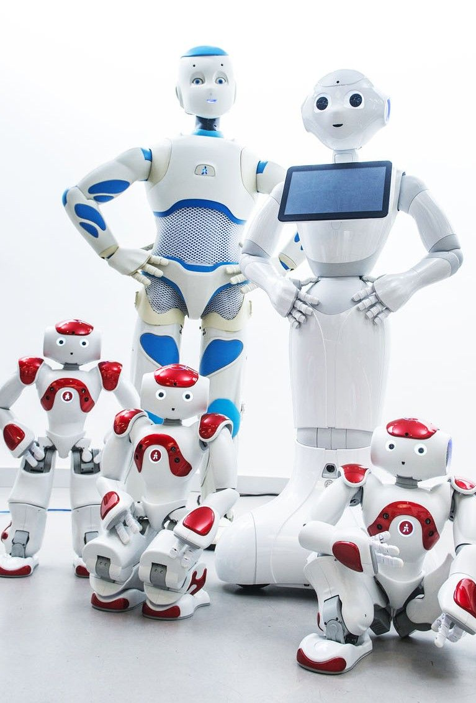
WHY HUMANOID robots?
A humanoid robot is a machine that resembles the human body structure and capabilities.
But… the human body is complex!
So why do we bother?

Slide 5
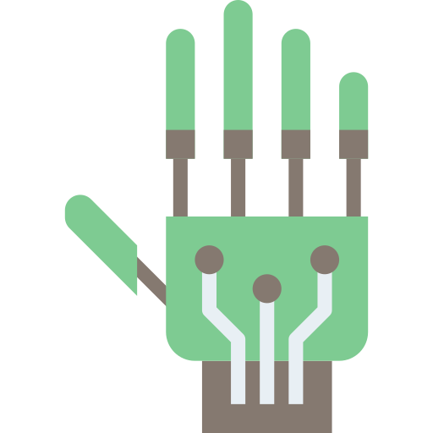
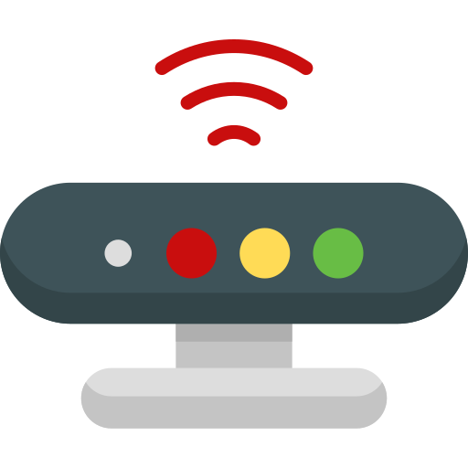
Autonomous robot workflow
Sensing
Reasoning
Acting
Actuators
Sensors

Slide 6
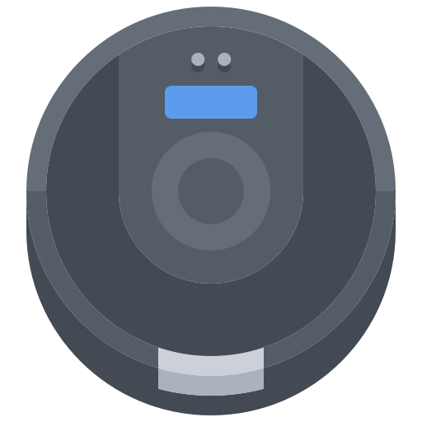
AUTONOMOUS ROBOT WORKFLOW
⋮
distance = sensor.get_distance()
if distance < 0.3:
wheels.stop()
⋮
Sensing
Reasoning
Acting
Notes:
Sensors and actuators are important… so let’s see Pepper’s

Slide 7
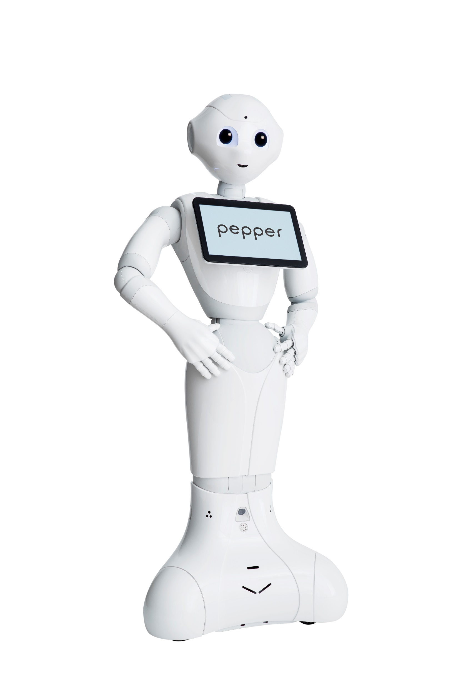
SOFTBANK PEPPER ROBOT
Manufactured in 2014 by SoftBank (formerly Aldebaran), a Japanese company.
«Pepper is intended to make people enjoy life, enhance people's lives, facilitate relationships, entertain and connect people with the outside world»
PROCESSOR | Atom E3845
CPU | Quad core
Clock speed | 1.91 GHz
RAM | 4 GB DDR3
GPU | Intel HD graphics 792 MHz

Slide 8
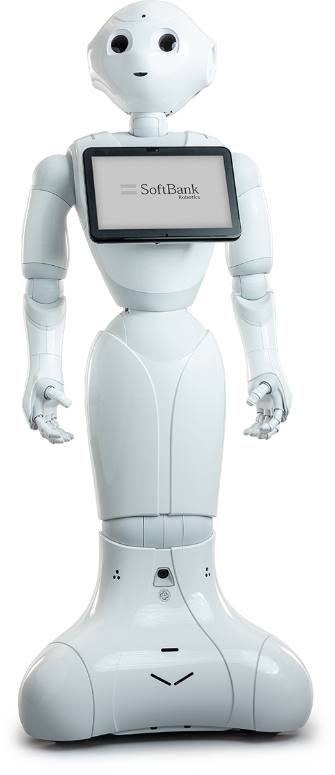
SOFTBANK PEPPER ROBOT
RGB cameras
Tactile sensors
Microphones
Depth cameras
Speakers
Gyroscope
Tablet
Inertial sensors
Tactile sensors
Lasers
Sonars
Bumpers
Omnidirectional wheels

Slide 9
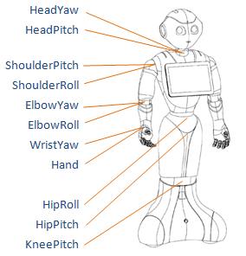
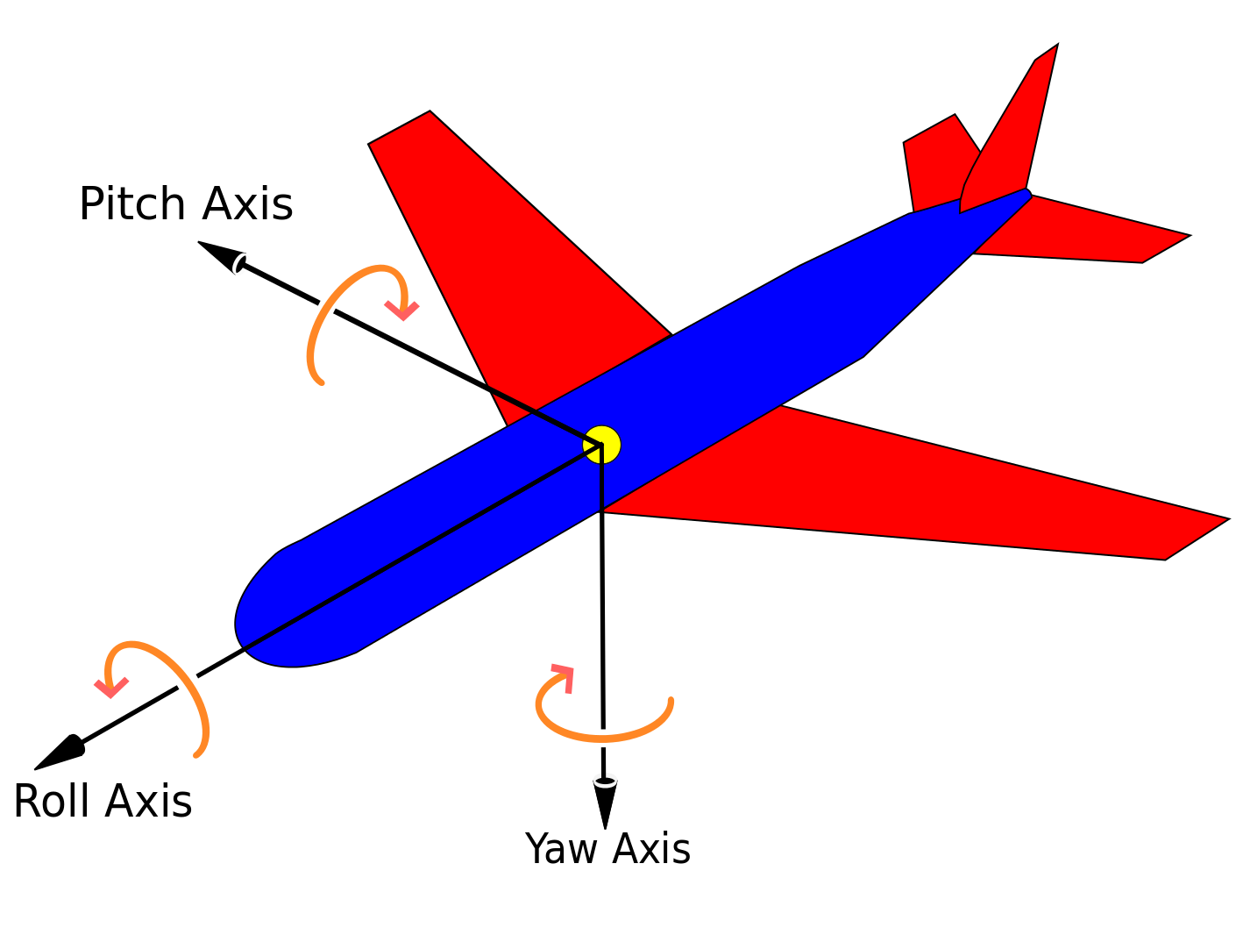
SOFTBANK PEPPER ROBOT
3D rotational axes (roll, pitch yaw)

Slide 10
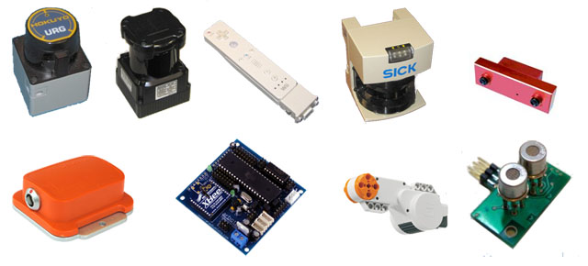
Robotics middleware
Sensors and actuators are not standardized but produced by different makers.
A robot is a collection of heterogeneous hardware pieces.
Problem: how do we control all these devices from the application level?

Slide 11
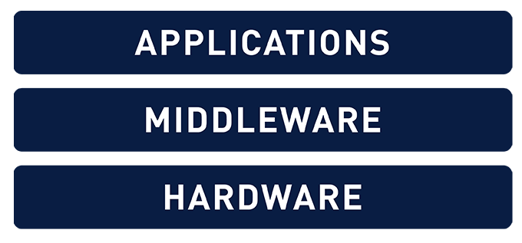
Robotics middleware
Middleware is quite a fuzzy term.
Broadly, it’s a software layer that connects several different systems.
In robotics, it’s a layer between hardware and software.
"Software glue".

Slide 12
Robotics middleware
"...robotic middleware is designed to manage the complexity and heterogeneity of the hardware and applications, promote the integration of new technologies, simplify software design, hide the complexity of low-level communication and the sensor heterogeneity of the sensors, improve software quality, reuse robotic software infrastructure across multiple research efforts, and to reduce production costs."
Elkady (2012)

Slide 13
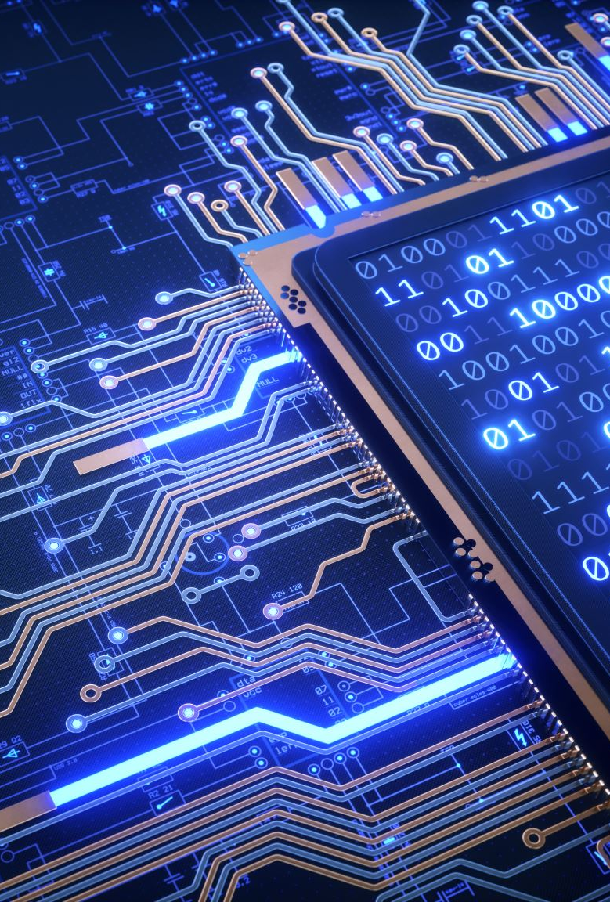
Robotics middleware
Advantages:
Modularity
Reconfigurability
Reduced coupling
Language independent
Middleware takes care of:
Information sharing
Timing
Data buffering
Hardware abstraction

Slide 14
Robotics middleware
Middleware
RGB cameras
Microphone
Sonar
Wheels
Path planning
Face detector
Speech recognition
Find Sarah Connor
Both application and hardware elements are considered "nodes" which are connected by the middleware infrastructure.
Each node specifies its inputs and outputs.

Slide 15

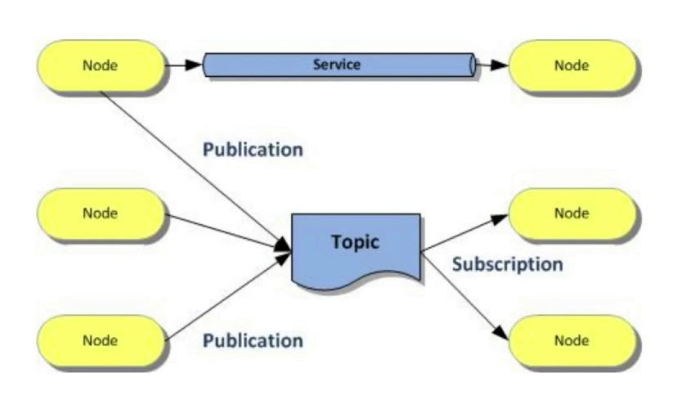
Middleware case study: ROS
Robot Operating System (not an OS though!)
Most widespread robotics middleware. Open source, thousands of projects, documentation and supported by the community.
Nodes publish on topics which are read by subscriber nodes (e.g.: a camera streaming images).
Other communication mechanisms (e.g. on-demand "services").

Slide 16
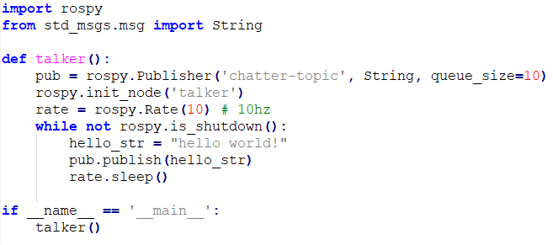
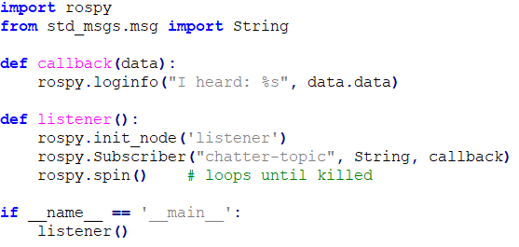
Middleware case study: ROS
Subscriber
Publisher

Slide 17

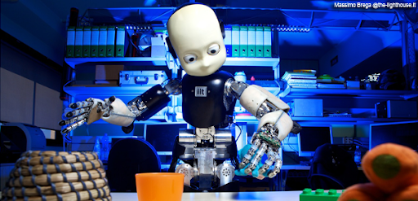
Middleware case study: YARP
Yet Another Robot Platform
Very similar to ROS, uses the same publisher/subscriber protocol.
Smaller community, used mainly for certain robots (e.g. iCub).
Mainly C++, bindings for other languages.

Slide 18
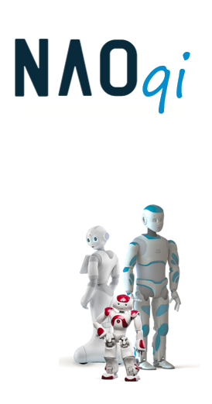
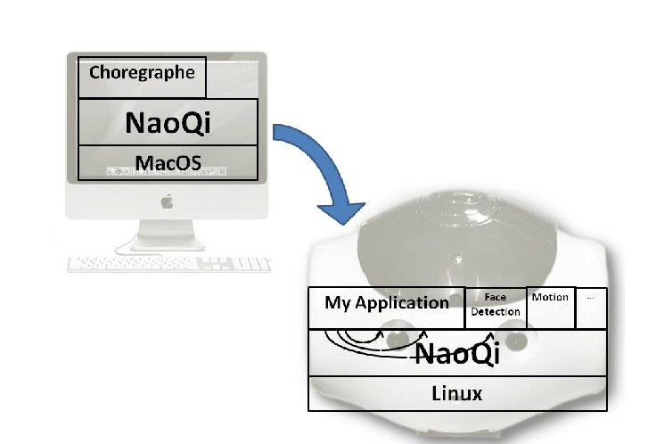
Middleware case study: naoqi
Proprietary software of SoftBank Robotics.
Used across their robots: Nao, Pepper and Romeo.
Interfaces in Python and C++.
More about this later on…

Slide 19
PROGRAMMING PEPPER
ROS
Choregraphe
Python C++

Slide 20

CHoregraphe
Easiest way of programming the robot.
No code: only graphical blocks that are combined to form behaviors.
Useful for:
Learning robot programming
Developing simple behaviors
Simulation
Monitoring the robot
Designing animations
http://doc.aldebaran.com/2-5/software/choregraphe/tutos/index.html

Slide 21
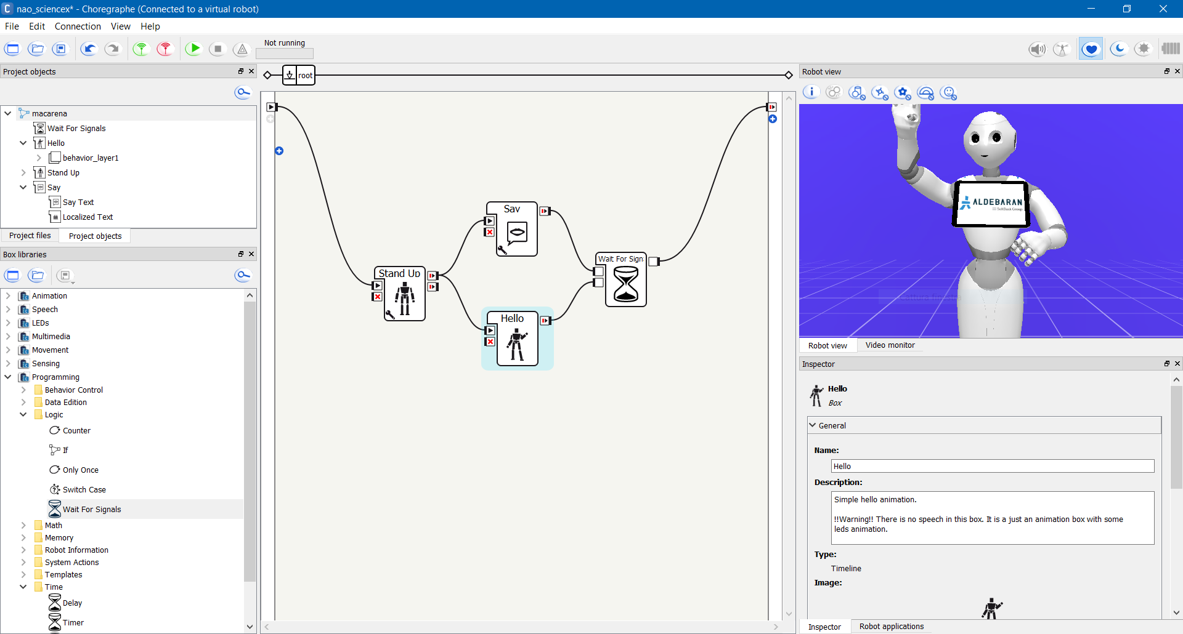
Choregraphe OVERVIEW

Slide 22
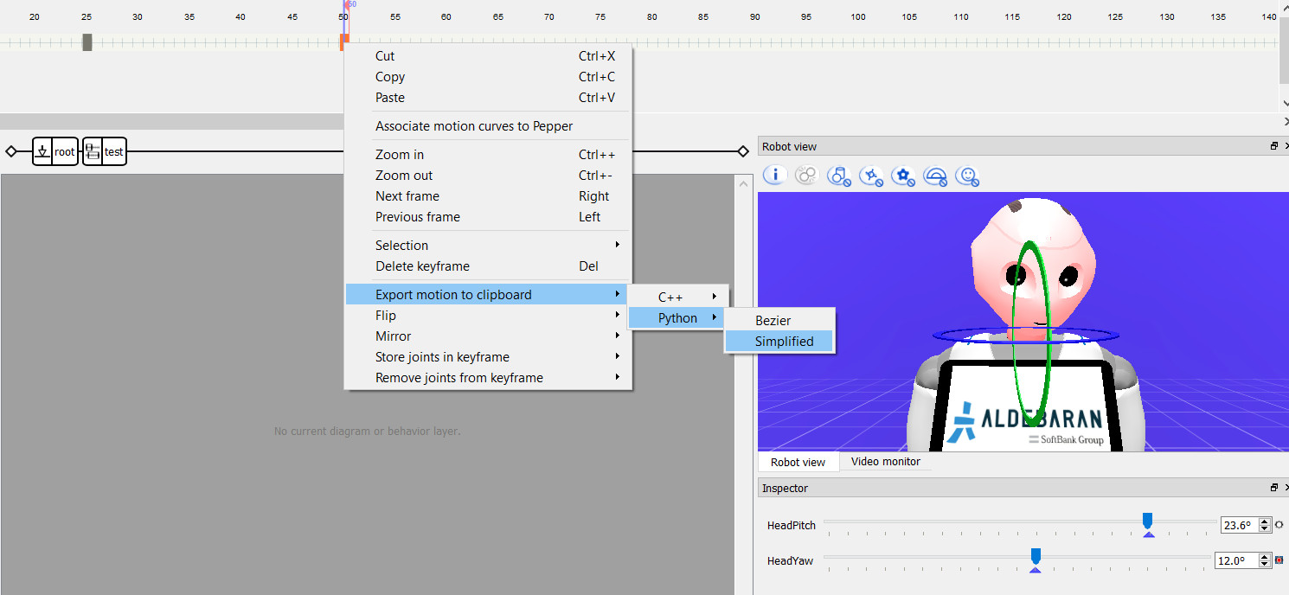
CHOREGRAPHE OVERVIEW

Slide 23
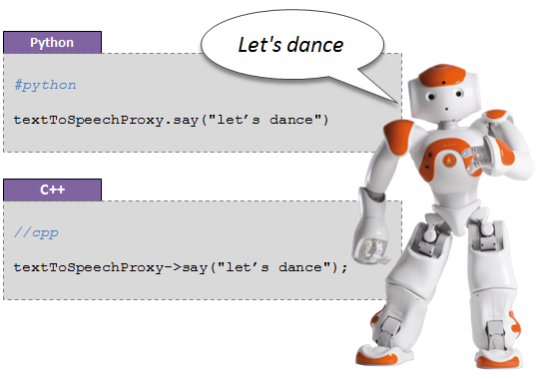
PYTHON PROGRAMMING
NAOqi is the name of the main software that runs on the robot and controls it.
Interfaces in Python and C++.
http://doc.aldebaran.com/2-5/dev/naoqi/index.html

Slide 24
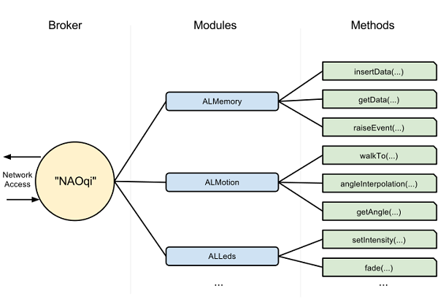
PYTHON programming

Slide 25
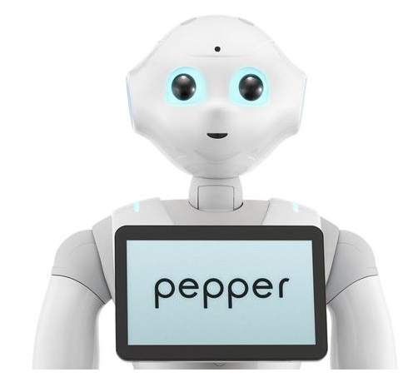
PYTHON PROGRAMMING
from naoqi import ALProxy
IP = "pepper.local"
PORT = 9559
tts = ALProxy("ALTextToSpeech", IP, PORT)
tts.setLanguage("English")
tts.say("Hello, world!")
Hello, world!

Slide 26
PYTHON PROGRAMMING
Talks after walking
from naoqi import ALProxy
IP = "pepper.local"
PORT = 9559
motion = ALProxy("ALMotion", IP, PORT)
tts = ALProxy("ALTextToSpeech", IP, PORT)
motion.moveInit()
motion.moveTo(0.5, 0, 0) # (x; y; theta)
tts.say("I am walking")
from naoqi import ALProxy
IP = "pepper.local"
PORT = 9559
motion = ALProxy("ALMotion", IP, PORT)
tts = ALProxy("ALTextToSpeech", IP, PORT)
motion.moveInit()
id = motion.post.moveTo(0.5, 0, 0) # (x; y; theta)
motion.wait(id, 0)
tts.say("I have walked")
Talks while walking

Slide 27
Python programming
Useful modules to keep in mind (check documentation for full API description):
ALVideoDevice
ALTextToSpeech
ALAnimatedSpeech
ALMotion
ALFaceTracker
ALLeds
ALLandmarkDetection
ALMemory
ALSpeechRecognition
API documentation: http://doc.aldebaran.com/2-5/naoqi/index.html (you'll need it!)

Slide 28
Preparing for the practical labs
Download VirtualBox from: https://www.virtualbox.org/
Download the virtual machine (~5Gb) with all the required software already pre-installed from: https://mega.nz/file/11IjgCBb#LgIEon7rWvKYGGK92VoRZXg26afFEJ2LcxcR1VDeWH0
Launch VirtualBox. In the top menu, click on “File”, then “Import Appliance…” and select the OVA file you just downloaded. Click “Next”, then “Import”.
(For Mac users) Be sure to follow this guide to allow the program to run correctly: https://medium.com/@Aenon/mac-virtualbox-kernel-driver-error-df39e7e10cd8

